Slide 1
Movie Recommendation System
Tech Titans
NAME | ENROLLMENT NO
JAINAM R SHAH | AU2040186
YASH CHOTALIYA | AU2040193
AKSHAY PARMAR | AU2040199
SHUBHAM BHATT | AU2040206

Slide 2
Introduction and Problem Statement
Movie recommendation systems are an essential part of many streaming platforms, providing users with personalized suggestions on what to watch next. Collaborative filtering is a popular technique used in building such systems, where the system recommends movies to a user based on the preferences of similar users.
The problem statement for this project is to build a movie recommendation system using user based collaborative filtering.
The system should take into account user preferences, movie ratings, and other relevant information to suggest movies that a user is likely to enjoy.
The dataset for the project will include user ratings for different movies, and the system should be able to learn patterns and similarities between users to make accurate recommendations.
Then it recommends movies to users based on the viewing habits and preferences of other users who have similar interests.

Slide 3
Existing body of work
In collaborative filtering we can use several different approaches.
From the literature survey done on few research papers majority of the systems have used collaborating filtering. Filtering has been done using different algorithms like User KNN, Item KNN, Matrix Factorization, and SVD.
At few places they also used hybrid model of collaborative filtering.
Using these algorithms, recommendation systems have shown a high and improved prediction accuracy.

Slide 4
Our Approach
Step 1 : Data finding from kaggle of about 45,000 movies and 26 million of rating, from 1 to 5. (we used sample rating data)
Step 2 : Imported Python libraries for data processing, visualization, and similarity computation.
Step 3 : Loaded the ratings and movies data.
Step 4 : Aggregated ratings by movie and keep only movies with over 100 rating
Step 5 : Made visualizations of our data so we can identify trends and pattern in the data.
Step 6 : Created a user-item matrix and normalized it.
Step 7 : Calculated user-user similarity using Pearson correlation and cosine similarity.
Step 8 : Picked a user ID and find similar users based on user-user similarity.
Step 9 : Find movies that similar users have watched, remove movies that the target user has watched, and calculate a score for each movie based on user similarity and movie ratings
Step 10 : Rank the movies by score and recommend top movies to the target user.

Slide 5
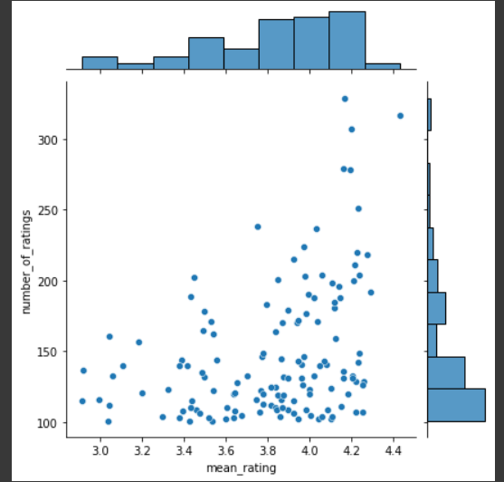
Initial Results
The x-axis represents the mean rating for each movie, and the y-axis represents the number of ratings each movie received. The plot displays a scatter plot of points, with each point representing a movie. The joint plot also includes a histogram for each axis showing the distribution of the data.
The graph will help to visualize the relationship between the mean rating and the number of ratings for movies in the dataset. It can give us an idea of whether highly rated movies tend to receive more number of ratings or whether movies with more number of ratings tend to have higher ratings. We can also use the plot to identify any outliers or patterns in the data.

Slide 6
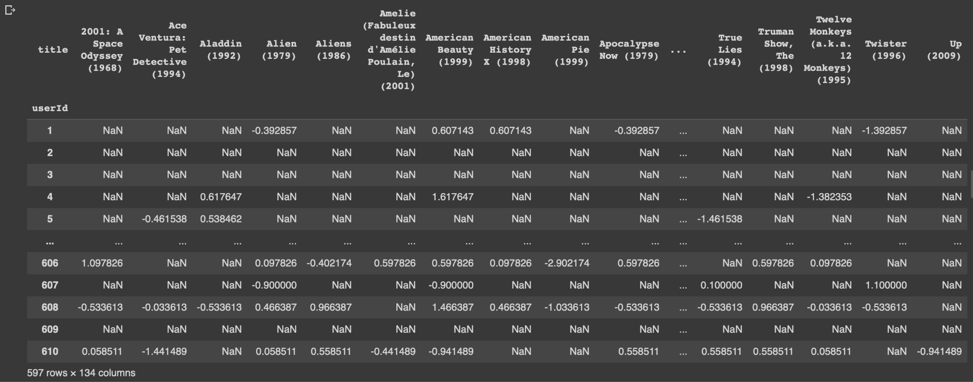
Initial Results (Continued)
The matrix above is a user-item matrix.It shows the ratings given by each user to each movie they have rated, with users in rows and movies in columns.
The rows represent each unique user ID and the columns represent each unique movie title.
The values in the matrix represent the ratings given by each user to each movie they have rated. If a user has not rated a particular movie, then the corresponding value in the matrix will be NaN.
This matrix is useful in collaborative filtering, as it allows us to compute similarity between users or items (in this case, movies) based on their rating patterns.

Slide 7
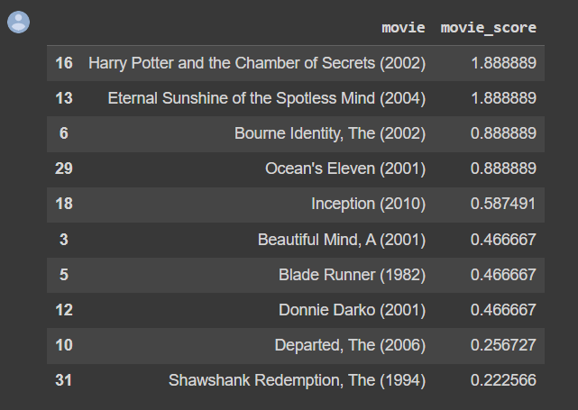
Initial Results (Continued)
Here we get the top 10 recommended movies based on the user's similarity to other users and their ratings for those movies.
We lists the movies along with their corresponding scores, which were calculated as the weighted average of the ratings given by similar users.
The movies are sorted in descending order of their scores, with the highest-scoring movies appearing at the top of the table.
These movies are the ones that are most likely to be enjoyed by the user based on their past movie ratings and the ratings of similar users.

Slide 8
FUTURE WORK
Further we can divide the whole dataset into 20% test set and 80% train set and train the model more perfectly.
We can check the model accuracy using RMSE and using that result we can improve the performance of the model.

Slide 9
Role of Each Group Member
Akshay Parmar: Data filtering, Data Visualization.
Jainam Shah: Model implementation and Data preprocessing
Shubham Bhatt: Data preprocessing and Initial Results
Yash Chotaliya: Model implementation and Initial Results

Slide 10
References
[1] Wu, C. S. M., Garg, D., & Bhandary, U. (2018, November). Movie recommendation system using collaborative filtering. In 2018 IEEE 9th International Conference on Software Engineering and Service Science (ICSESS) (pp. 11-15). IEEE.
[2] Lavanya, R., & Bharathi, B. (2021). Movie Recommendation System to Solve Data Sparsity Using Collaborative Filtering Approach. Transactions on Asian and Low-Resource Language Information Processing, 20(5), 1-14.
[3] Geetha, G., Safa, M., Fancy, C., & Saranya, D. (2018, April). A hybrid approach using collaborative filtering and content based filtering for recommender system. In Journal of Physics: Conference Series (Vol. 1000, No. 1, p. 012101). IOP Publishing.
[4] Anwar, T., & Uma, V. (2021). Comparative study of recommender system approaches and movie recommendation using collaborative filtering. International Journal of System Assurance Engineering and Management, 12, 426-436

